Slide 1

Python Stock Tracking Project
Devry university
CEIS 150
Kwame Austin
12.15.2023

Slide 2

Agenda
Introduction
Software Environment Setup
Class Diagrams/Class Coding/Unit Testing
Creating a Console-based Interface
Inheritance Summary Report
Creating a Chart
Files
Loading Data
Graphic User Interface
Lessons Learned
Career Skills Gained

Slide 3
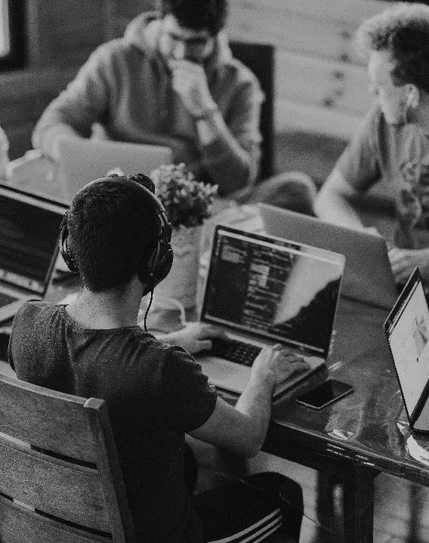
INTRODUCTION
Stock Tracking Application
Using object-oriented techniques developed a stock tracking application. The application has both a console and a GUI (Graphical User Interface). By processing the historical stock data, profit/loss reports can be generated. The system uses Python libraries to create charts and get historical stock data from websites.

Slide 4
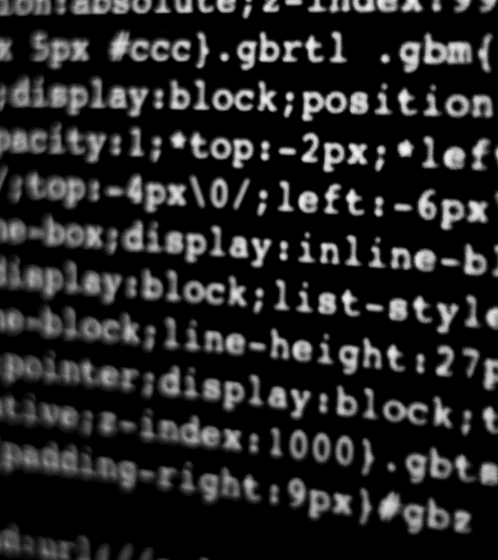
Software environment setup
Objective:
Install anaconda
Chose IDE
Create a python program

Slide 5
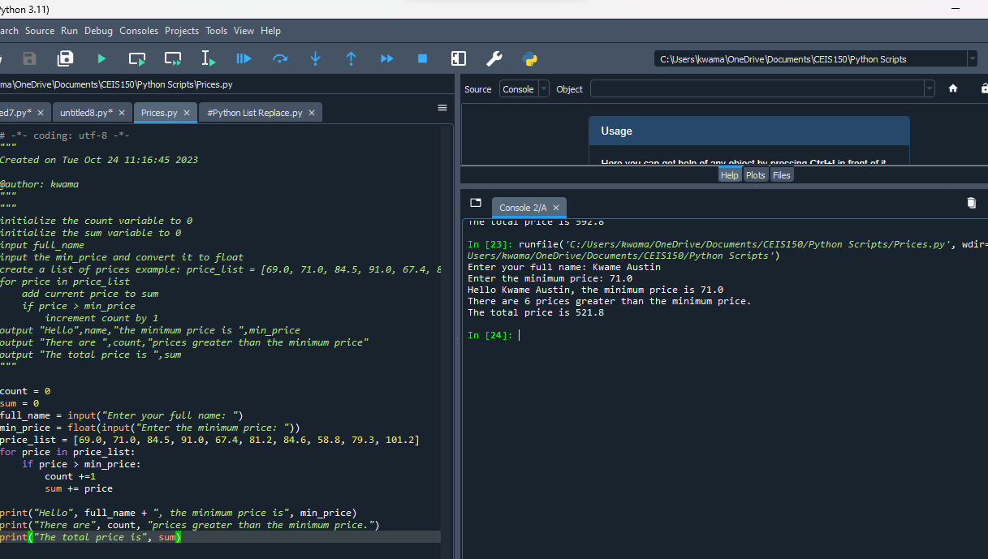
Python Program
Screen shot of shows Python program running successfully.

Slide 6
class diagrams/class coding/unit testing
Objective:
Create class diagrams
Create classes
Run unit test

Slide 7
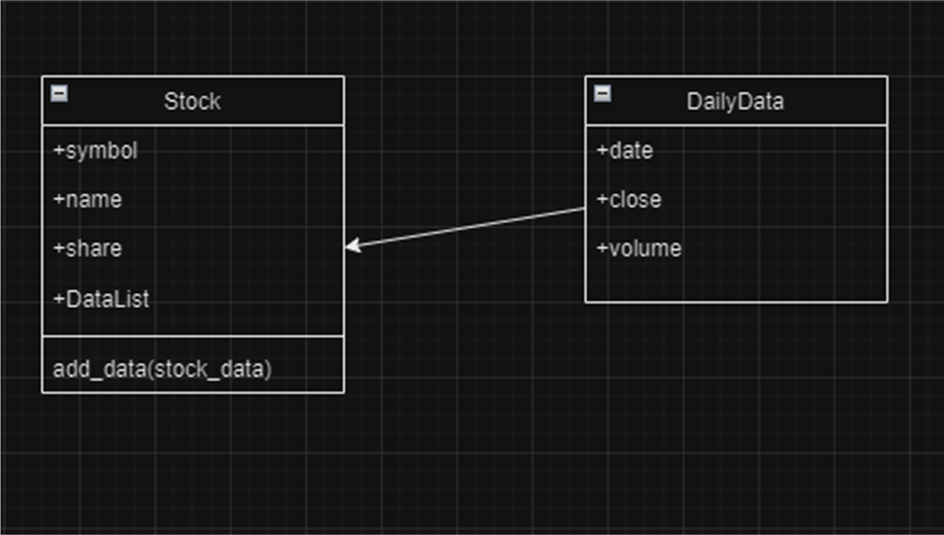
Visio
Class diagram
A Visio class diagram was used to document the functionality of the program. In the stock program, two related classes were used to keep track of our stock and price history data. Stock and DailyData

Slide 8
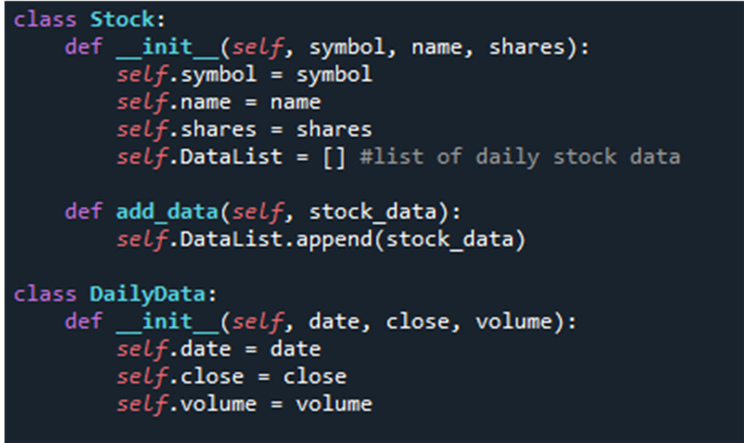
Class code
The following is a screenshot of the stock_class.py file.
This code was added to create unit tests, and testing to make sure the correct behavior is actioned and will create a warning if there are problems in the classes.

Slide 9
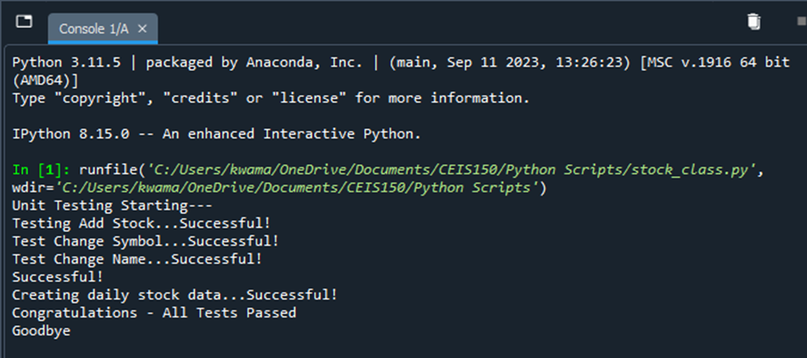
Successful unit test
The following shows a successful unit test.
The file unit tested attempts to create a new stock and add price history to the stock. It also tested changing the stock symbol, the symbol, and change the name. The unit test produced a report showing which all tests passed.

Slide 10
Creating a console-based interface
Objective:
Create a menu-driven user interface to add/list/delete stocks and to track price and volume history
Create functions to handle menu items

Slide 11
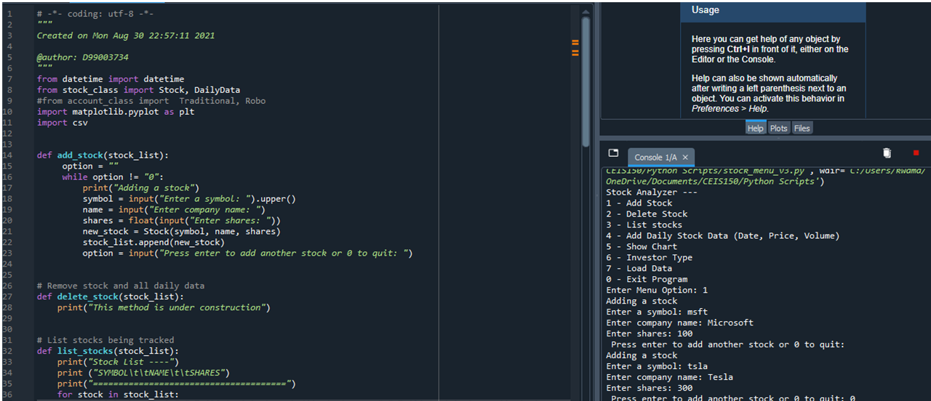
Adding a stock
Screen shot of shows the Stock Program working adding a stock.

Slide 12
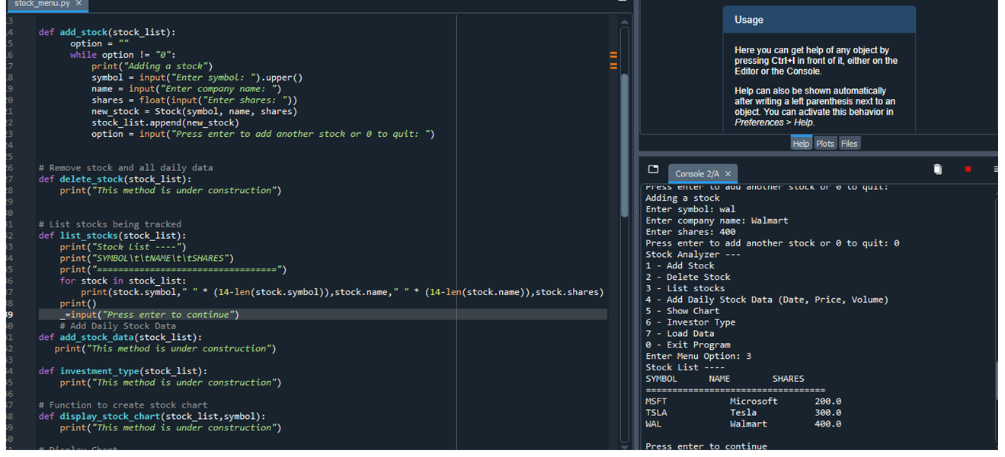
Listing stocks
Screen shot of shows Stock Program listing stocks.

Slide 13
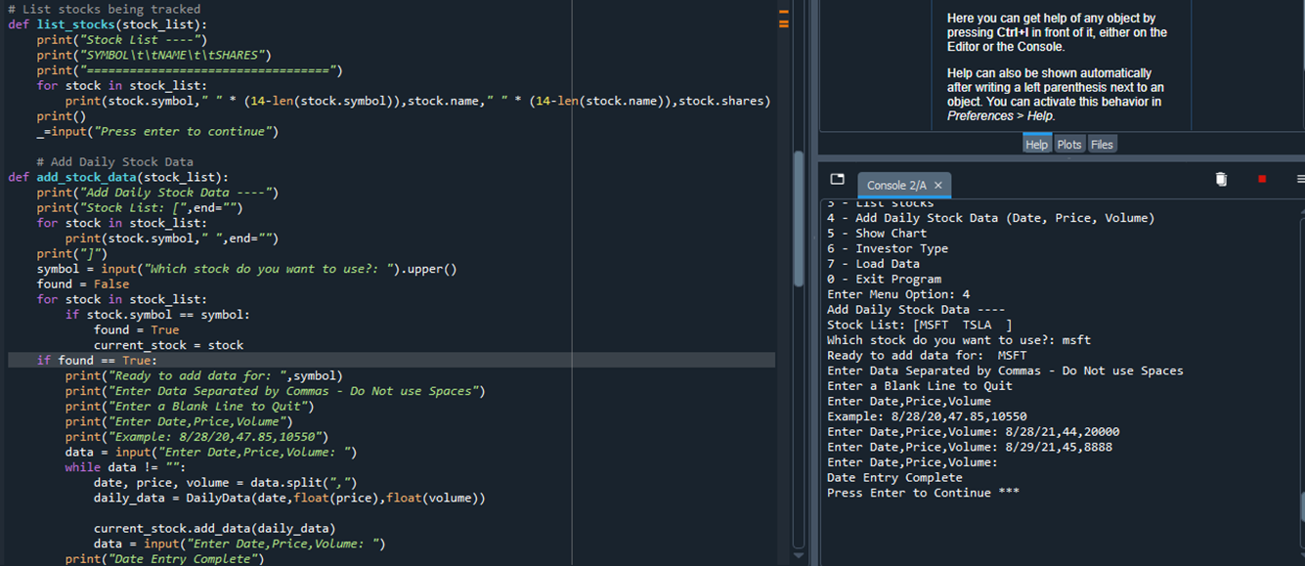
Daily data
Screen shot of shows Stock program displaying daily stock data.

Slide 14
Inheritance summary report
Objective:
Implement inheritance in the stock program
Create three classes
Run Unit Test

Slide 15
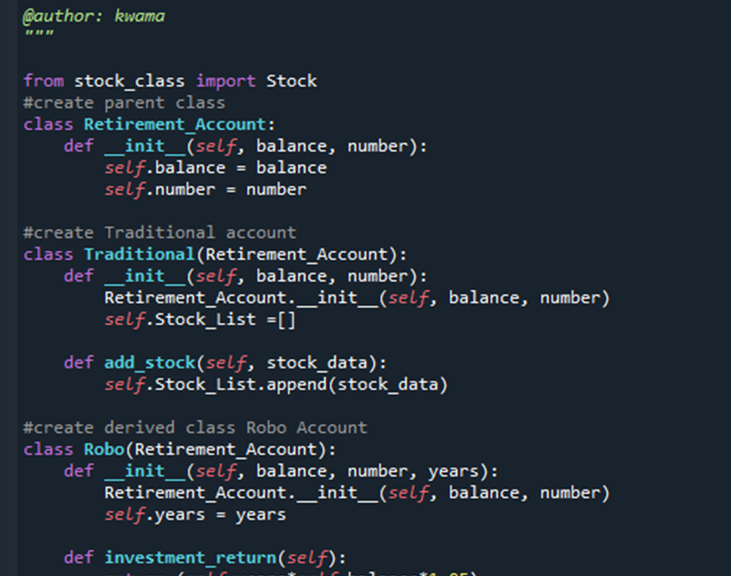



Inherited classes
Screen shot of shows the inherited classes: Retirement /Traditional/ Robo

Slide 16
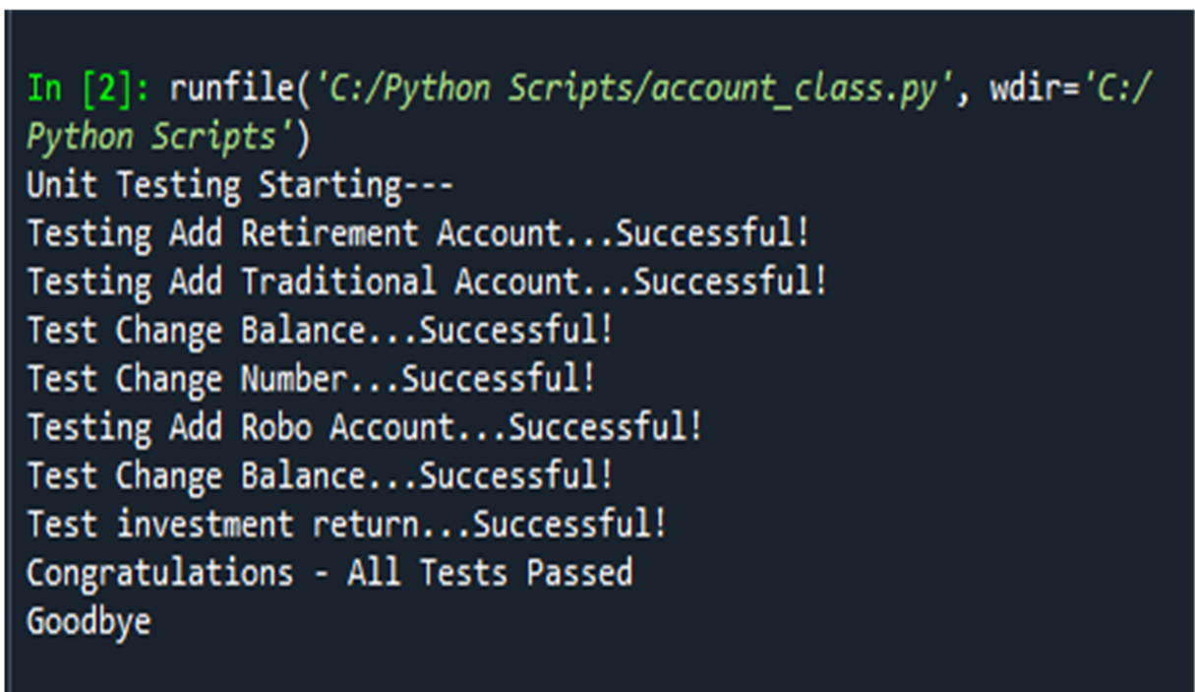
Unit tests
Screen shot of unit test completed successfully.

Slide 17
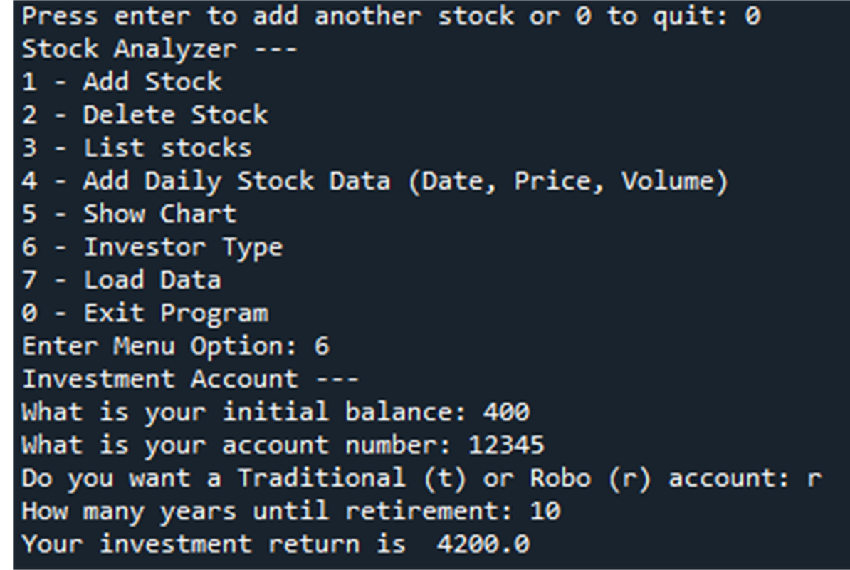
Stock menu program
Screen shot shows classes displayed in the main program.

Slide 18
Creating a chart using the matplotlib
Objective:
Using the pyplot class in the matplotlib library to create a simple stock chart

Slide 19
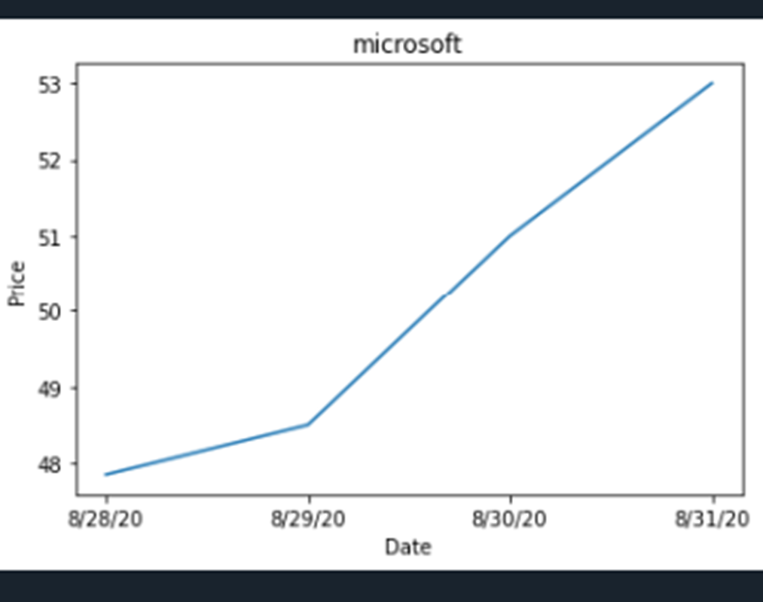
Stock chart
Screen shot shows a chart created to visualize stock price history. This is stock chart was created using the matplotlib library.

Slide 20
Working with files
Objective:
Using cvs library import data from Yahoo! Finance
Read data from a file

Slide 21
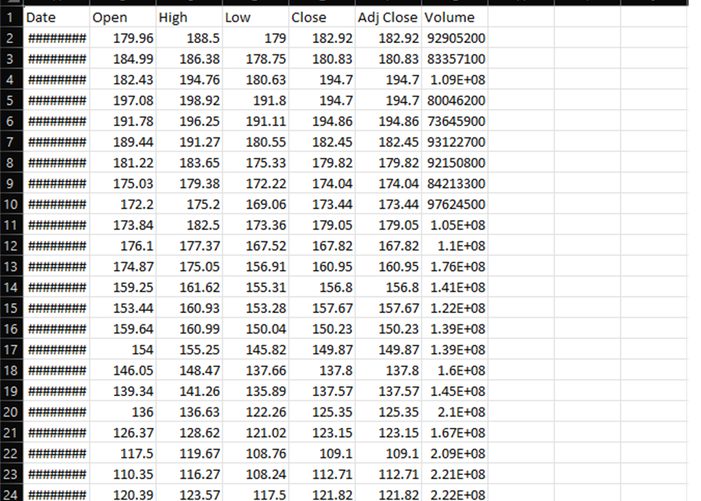
Csv file
Screen shot shows the csv file downloaded from Yahoo Finance

Slide 22
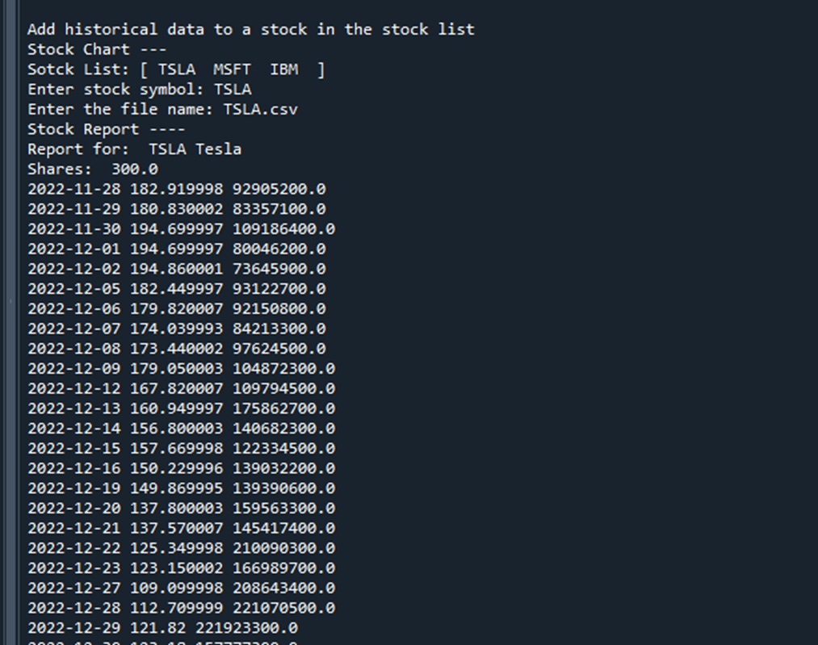
Importing data
Screen shot shows historical data imported.

Slide 23
Creating a graphical user interface
Objective:
Using tkinter to implement a graphical user interface.

Slide 24
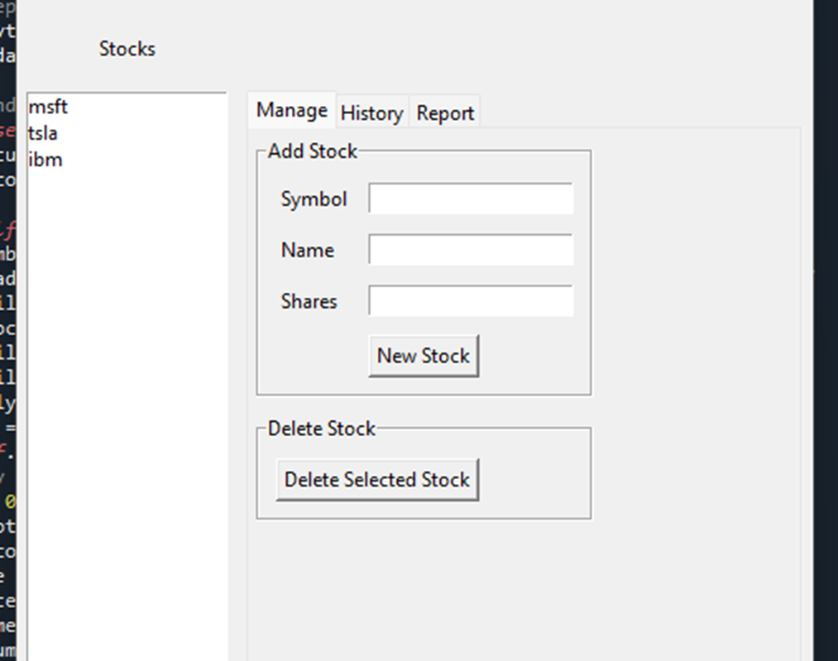
Stocks displayed in Graphic user interface (GUI)
Screen shot shows GUI displaying added stocks inputted through GUI interface

Slide 25
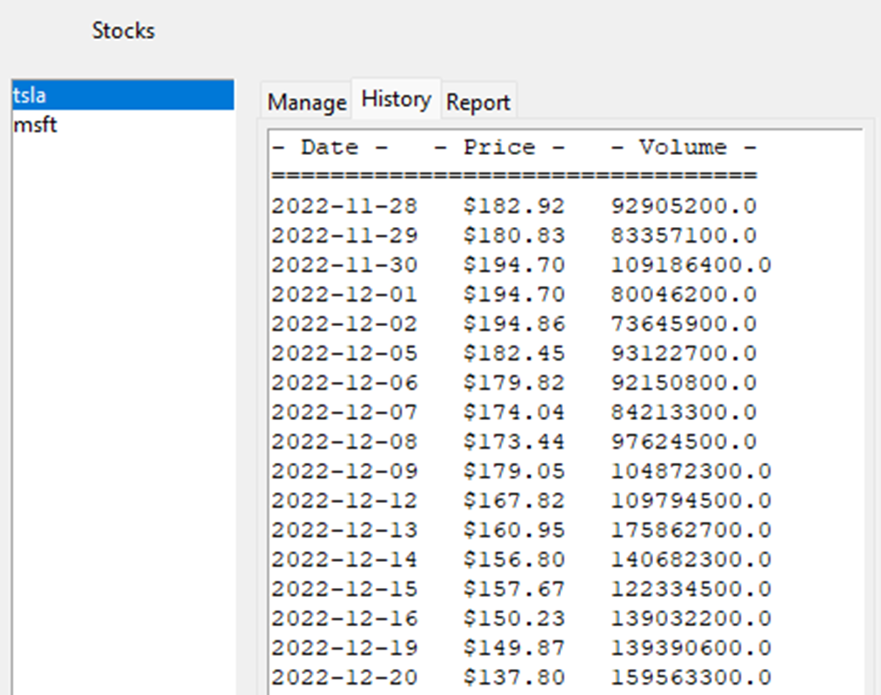
History tab
Screen shot shows the History function operating properly in the GUI

Slide 26
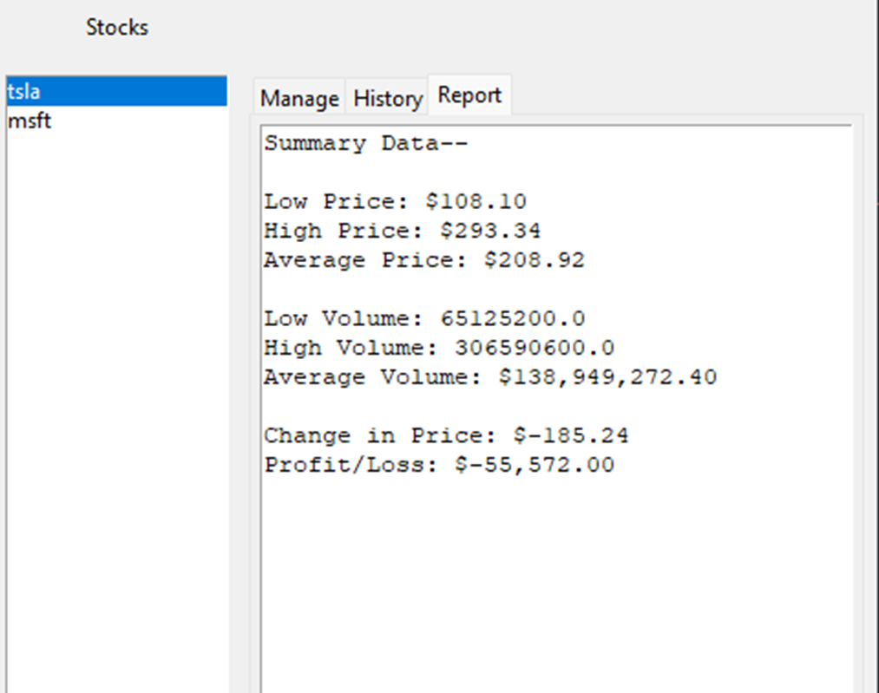
Full report complete
Screen shot shows the Report function showing the Summary Data of the selected stock.

Slide 27

This project showcases many skills and lessons learned.
The ability to understand the concepts of Object Oriented Programming.
The ability to build a program using classes.
Developing a program using inheritance.
Understanding and developing programs using Python libraries used for data storage, analysis, and data visualization.
Understanding basic concepts of functional programming in Python.
The ability to create programs using iterators and generators in Python.
Saving application data using files.
Producing an Object Oriented Python Program

Slide 28
Career Skills Developed:
Software Development
Data Analysis
Data Science
Machine Learning Engineering
Back-end Development

Slide 29

conclusion
This project allowed me the opportunity to display the many skills that I have been able to learn over the past 8 weeks in the CEIS 150 course here at DeVry University. Continuing self-study of the foundational techniques covered will allow to me further my capability to design and create many more applications, which can hopefully be leveraged one day into landing a bright and promising job in the I.T. career field.

Slide 30


THANK YOU
Kwame Austin
linkedin.com/kwameaustin/
kwameaustin.wixsite.com

